Slide 1
Automatic TA Assignment
Rajdeep Kaur
Srinidhi Nandakumar

Slide 2
The application assigns TAs to sections based on the experience, background and preferences of the TAs.
It consists of two main parts.
The front end allows the User and Admin to access the Web Portal to perform various functions
The backend uses the information fed by users and admin to match teaching assistants signed up with the portal to courses added by the admin
Introduction

Slide 3
Web Portal
Admin Dashboard
User
View Users
View User Preferences
Courses
Add Courses
Add Sections
View Courses
View Sections
Matching
Admin Override
Perform Matching
View Matching
Release/Block Matching
View Stats
User Dashboard
Background
Add personal details
View Personal Details
Add time constraints
View time constraints
Courses
View Courses and Sections
Submit Preferences
View Submitted Preferences
Matching
View Matching

Slide 4
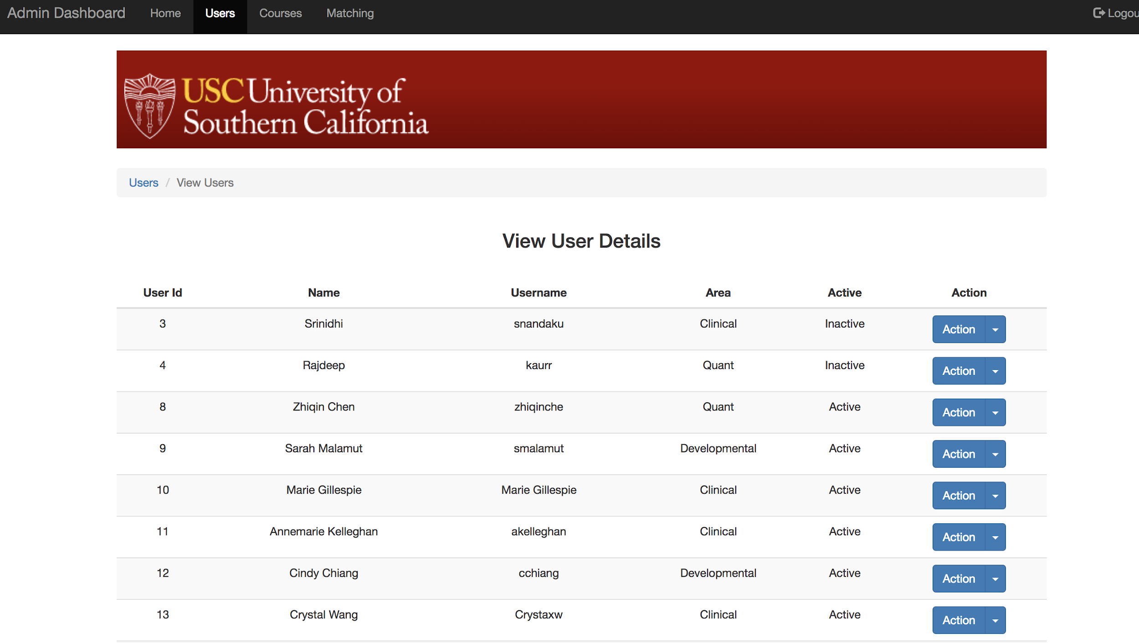

Slide 5
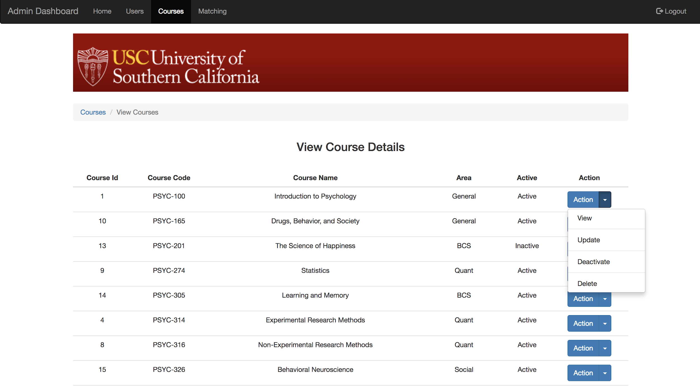

Slide 6
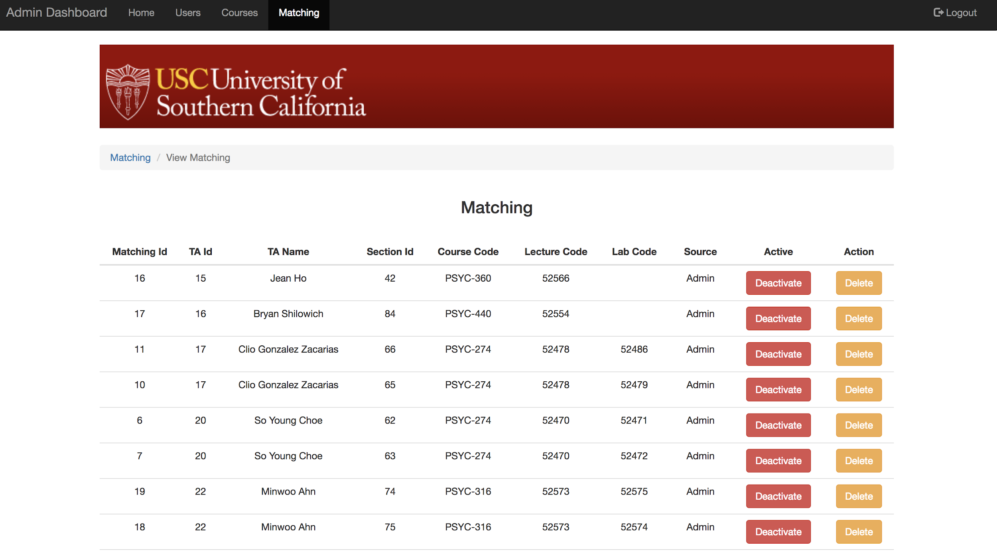

Slide 7
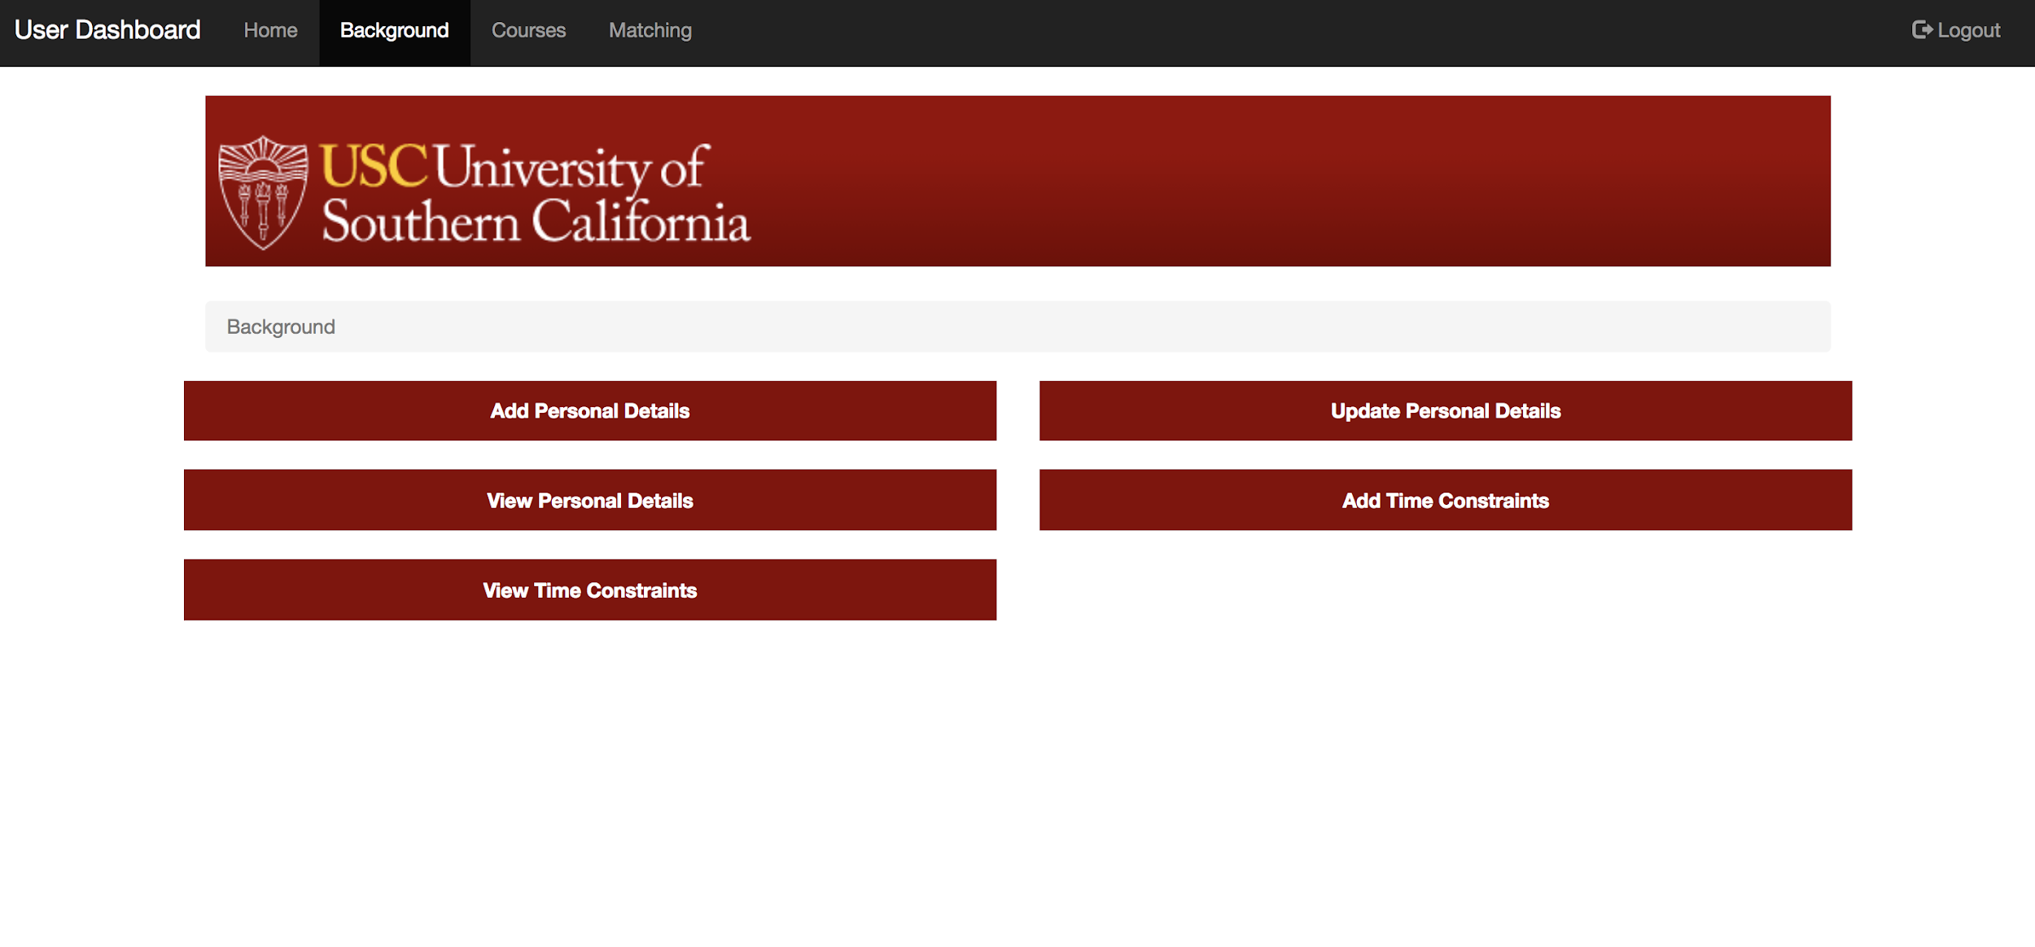

Slide 8
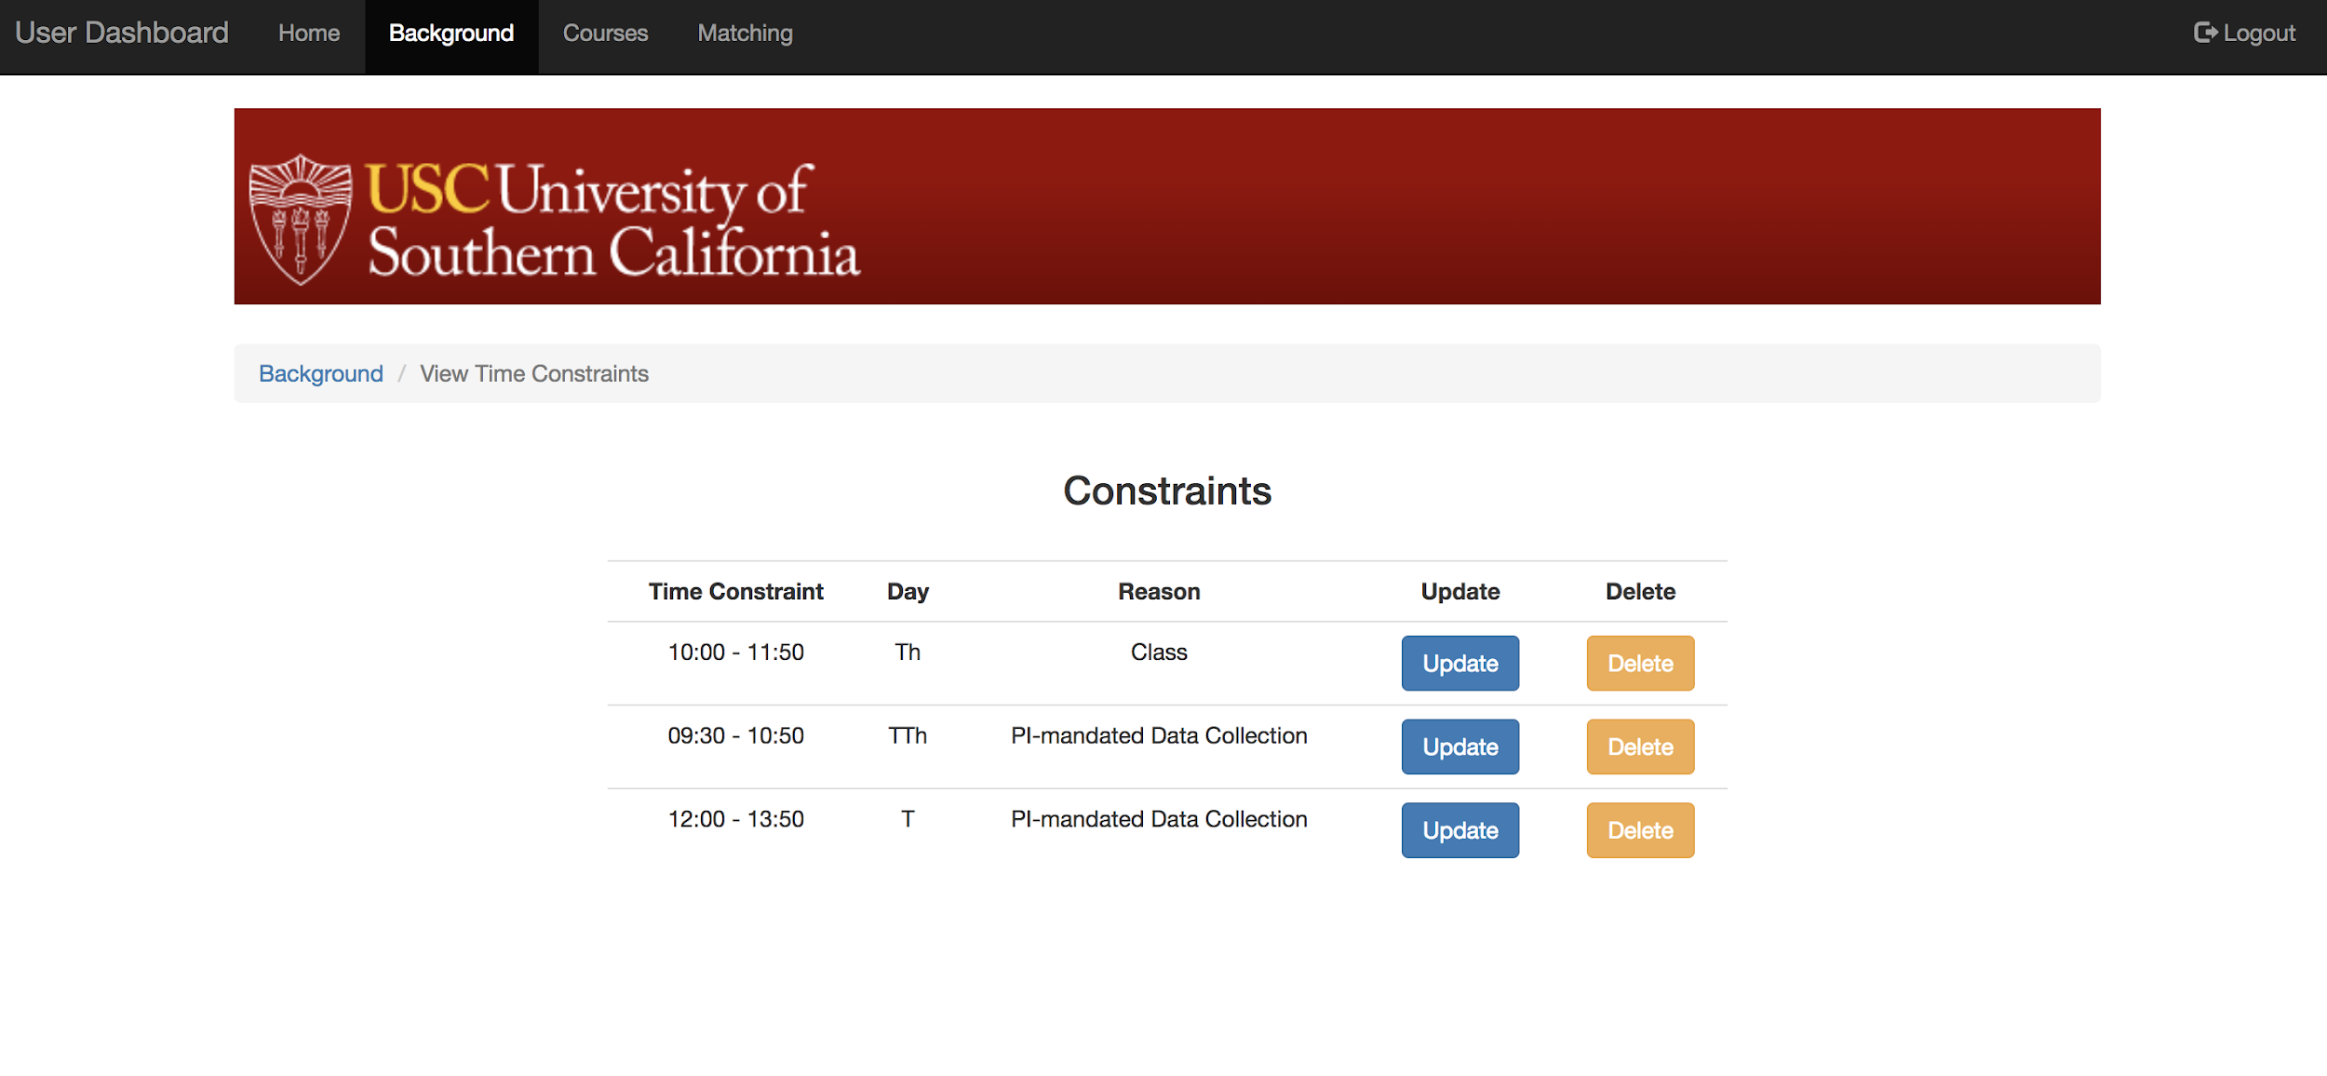

Slide 9
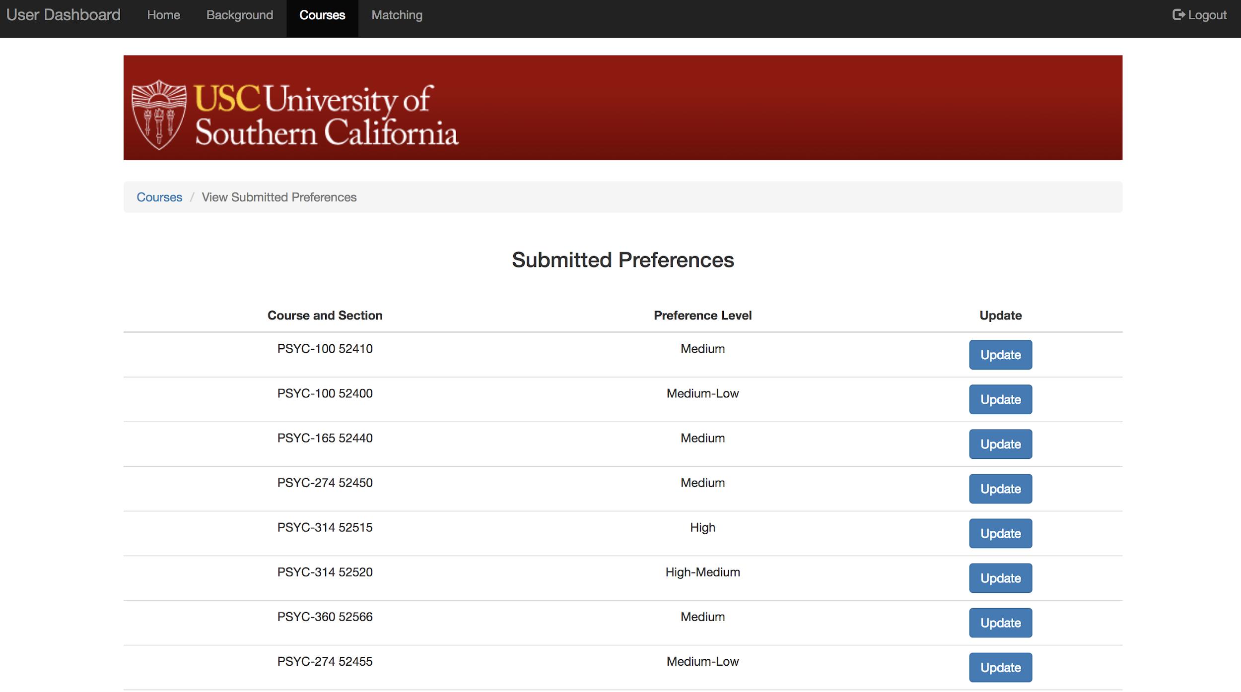

Slide 10
Back End
DATA POPULATION
Domain Object in java for each table in database
Example: Course.java, TA.java
Populate domain objects using mybatis and my-sqlconnector.
Create Map put of lists for each retrieval based on Id.
Enrich data;
Example : Fill TA domain object with score based on milestones.

Slide 11
Algorithm Flow
Get the admin matching and previous matching that is active.
Remove TA and course sections of above matching from available pool.
Calculate score of each ta based on milestone, no. of years of ta experience.
Populate the score in preference object for the TA : ta_score + if_happy_and taught this course_before(0.2) + if_its_Quant_course,Quant_Student add 5(very high score)

Slide 12
Algorithm Flow
For all the preference list in decreasing order of interest,
Eliminate preference object where TA time and Lecture Time and/or Lab Section Time clash;
For each section, sort the list of eligible TA’s based on score.
Modify this list by bringing forward the TA who taught this course and is happy and move back the one who is not happy and taught it last sem.
After this we get the list of eligible TA’s for each section in decreasing order of score.
Distribute these TA’s one by one to each of the section.
Keep removing the allocated TA and section from eligible list.

Slide 13
Algorithm Flow
This will give us one result of matching, if unsatisfied with any, remove them from UI and run the algorithm again.
Or, delete few and add admin override manually.

Slide 14
THANK YOU !!!

